Slide 1


JEPPIAAR ENGINEERING COLLEGE
Department of Computer Science And Engineering
HOUSE RENT APPLICATION USING MERN
Team Leader: Swetha Sri.A (310821104098)
Team Member 1 : Suganya.A (310821104095)
Team Member 2 : Vigosh.P (310821104109)
Team Member 3 : Shibivarman.M (310821104089)
Supervisor : Mrs. D. Jeevitha M.E.,
Assistant Professor,
Department of CSE

Slide 2

PROJECT OVERVIEW
Purpose:
Help tenants find rental properties quickly and allow landlords to list and manage properties efficiently.
Enable seamless interaction between landlords and tenants.
Build trust with features like detailed property information.
Feature:
User registration and login (landlord/tenant).
Property listing with descriptions, photos, and pricing.
Advanced search and filter functionality.
.

Slide 3
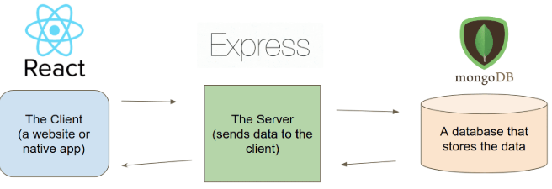
ARCHITECTURE

Slide 4
SETUP INSTRUCTIONS
PREREQUISITES
Before setting up the project locally, make sure you have the following
software installed on your machine:
Node.js: Node.js is a JavaScript runtime built on Chrome's V8
JavaScript engine. It is required to run both the frontend and backend of this
project.
MongoDB: MongoDB is a NoSQL database used to store user data,
job postings, bids, and messages
Postman API: To send data to a server to create,update,or delete a resource

Slide 5

STEP BY STEP GUIDE
1. Create a folder in VS Code:
Houserent application(project folder)
- Inside project folder, create 2 folders namely,
Frontend
Backend
2.Install Dependencies
Install required packages for both backend and frontend:
Frontend (React js):
cd client/
npm install
Backend (API):
cd api/
npm install
This installs dependencies like Express, MongoDB.

Slide 6
STEP BY STEP GUIDE
3.Configure Environment Variables:
Create a .env file in the backend folder, add environment variables like
MongoDB URI
JWT secret key
4.Create API Routes & Frontend Components:
Set up Express API routes in the backend.
Set up React components in the frontend.

Slide 7
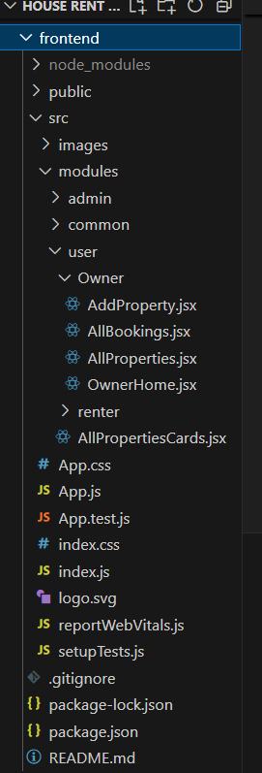
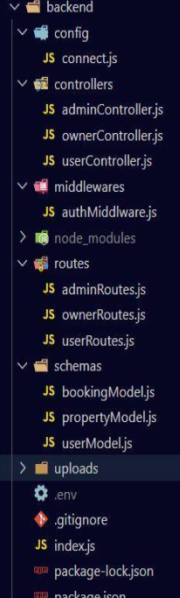
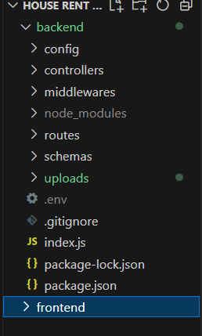
FOLDER STRUCTURE
Client -Frontend
Server -Backend

Slide 8
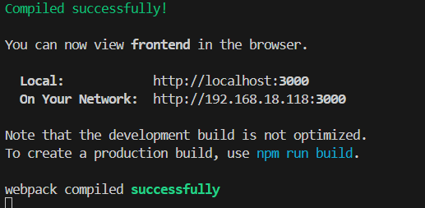
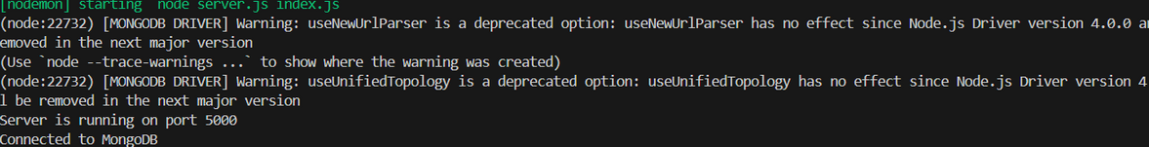
RUNNING THE APPLICATION
Start the FrontendServer:
Navigate to the client directory: cd frontend
Install the required dependencies: npm install
Start the frontend server:
npm start
Start the Backend Server:
. Navigate to the server directory: cd backend
Install the required dependencies: npm install
Start the backend server:
npm run dev

Slide 9
API DOCUMENTATION
User Authentication
Endpoint: POST auth/register
Description: Allows a new user (freelancer or client) to register.
Response: User registered successfully
Endpoint: POST auth/login
Description: Enables user login and returns a JWT token for session authentication.
Request Body:
Email: User's email address.
Password: User's account password.
Response:
A token string used for secure API interactions.

Slide 10
AUTHENTICATION
User Registration:
o Allows new users (tenants or landlords) to create an account
by providing necessary details like name, email, password,
and role.
o Passwords are securely hashed before storage.
o Generates a JSON Web Token (JWT) on successful
authentication.
Role-Based Access Control (RBAC):
o Restricts access to certain features based on user roles (e.g.,
only landlords can list properties).

Slide 11
USER INTERFACE
Landing Page
Search bar for properties .
Call-to-action buttons (e.g., "Sign Up" or "Post a property").
Registration and Login
Input fields for email, password, name, and role selection
(tenant or landlord).
Error messages for validation issues(eg:”Invalid email”)
Dashboard
Tenant View:
Saved properties, payment status, and rental history.
Landlord View:
Property listings, tenant applications, and earnings
overview.

Slide 12
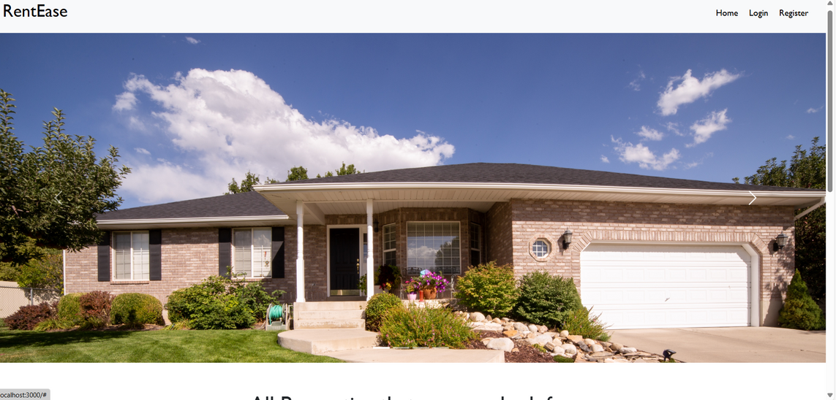
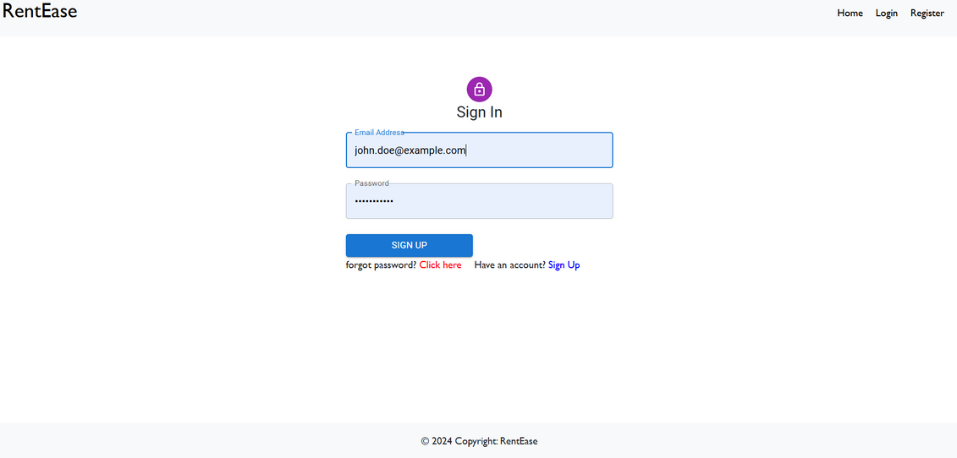
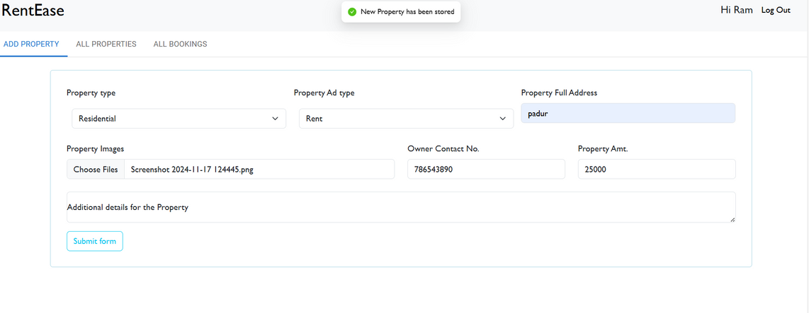
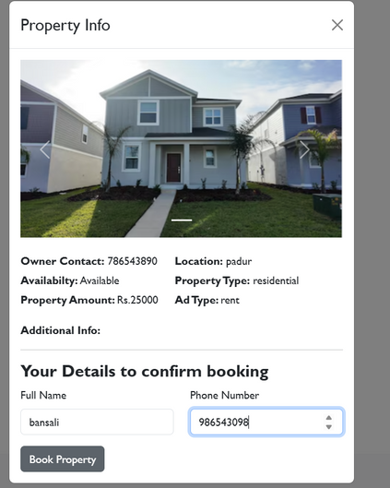
SCREENSHOTS

Slide 13
TESTING
1. Frontend Testing:
o Jest: For unit and integration tests of React components.
2. Backend Testing:
o Postman: For API testing and request validation.
o Supertest: For automated API tests in Node.js.
3. Performance Testing:
o JMeter: For load and stress testing.
4. Security Testing:
o OWASP ZAP: For vulnerability scanning.
5. Database Testing:
o Custom SQL scripts to validate data consistency.

Slide 14
KNOWN ISSUES
Frontend Issues
• Form Validation Problems:
o Certain edge cases bypass client-side validation, e.g., special
characters in name fields or invalid email formats.
• Cross-Browser Compatibility:
o Features or styles may not render consistently across different
browsers (e.g., Safari vs. Chrome).
Backend Issues:
Authentication Errors:
Token expiration not handled properly, causing users to be
logged out unexpectedly.
Concurrent updates (e.g., multiple users editing the same property)

Slide 15
FUTURE ENHANCEMENTS
Advanced Search and Filters
• Enhancement: Add filters for amenities (e.g., pet-friendly, parking,
furnished), neighbourhood ratings, and proximity to landmarks.
• Benefit: Improves the user experience by making property
discovery more precise.
Enhanced Security
• Enhancement: Introduce multi-factor authentication (MFA) and
biometric logins for enhanced user account security.
• Benefit: Protects user data and reduces the risk of unauthorized
access.

Slide 16
THANK YOU

